Slide 1
A Novice’s Approach to
Topical Stamp Collecting
My interests in Hansen’s Disease (HD) or leprosy led to an interest in collecting stamps related to HD with no preconceived ideas about how many or how interesting such stamps might be
Notes:
MOST KNOW MY INTEREST IN HANSEN’S DISEASE (LEPROSY)
led to an interest in collecting stamps related to HD with no preconceived ideas about how many or how interesting such stamps might be
DABBLED IN COLLECTING BOY SCOUT STAMPS
- Never realizing that every country that exists of ever existed has stamps honoring Lord Baden Powell and Scouting

Slide 2
Combining Two Passions
Hansen’s Disease (HD)
Stamp Collecting
Next slide features an article of mine that was published in The STAR, a periodical dedicated to “radiating the truth” about HD
Notes:
- One of the many “beauties” of stamp collecting is the ability to combine two passions of our lives (art and stamps, nursing and stamps, transportation and stamps and so on with virtually endless combinations of passions/interests and topical stamp collecting.

Slide 3
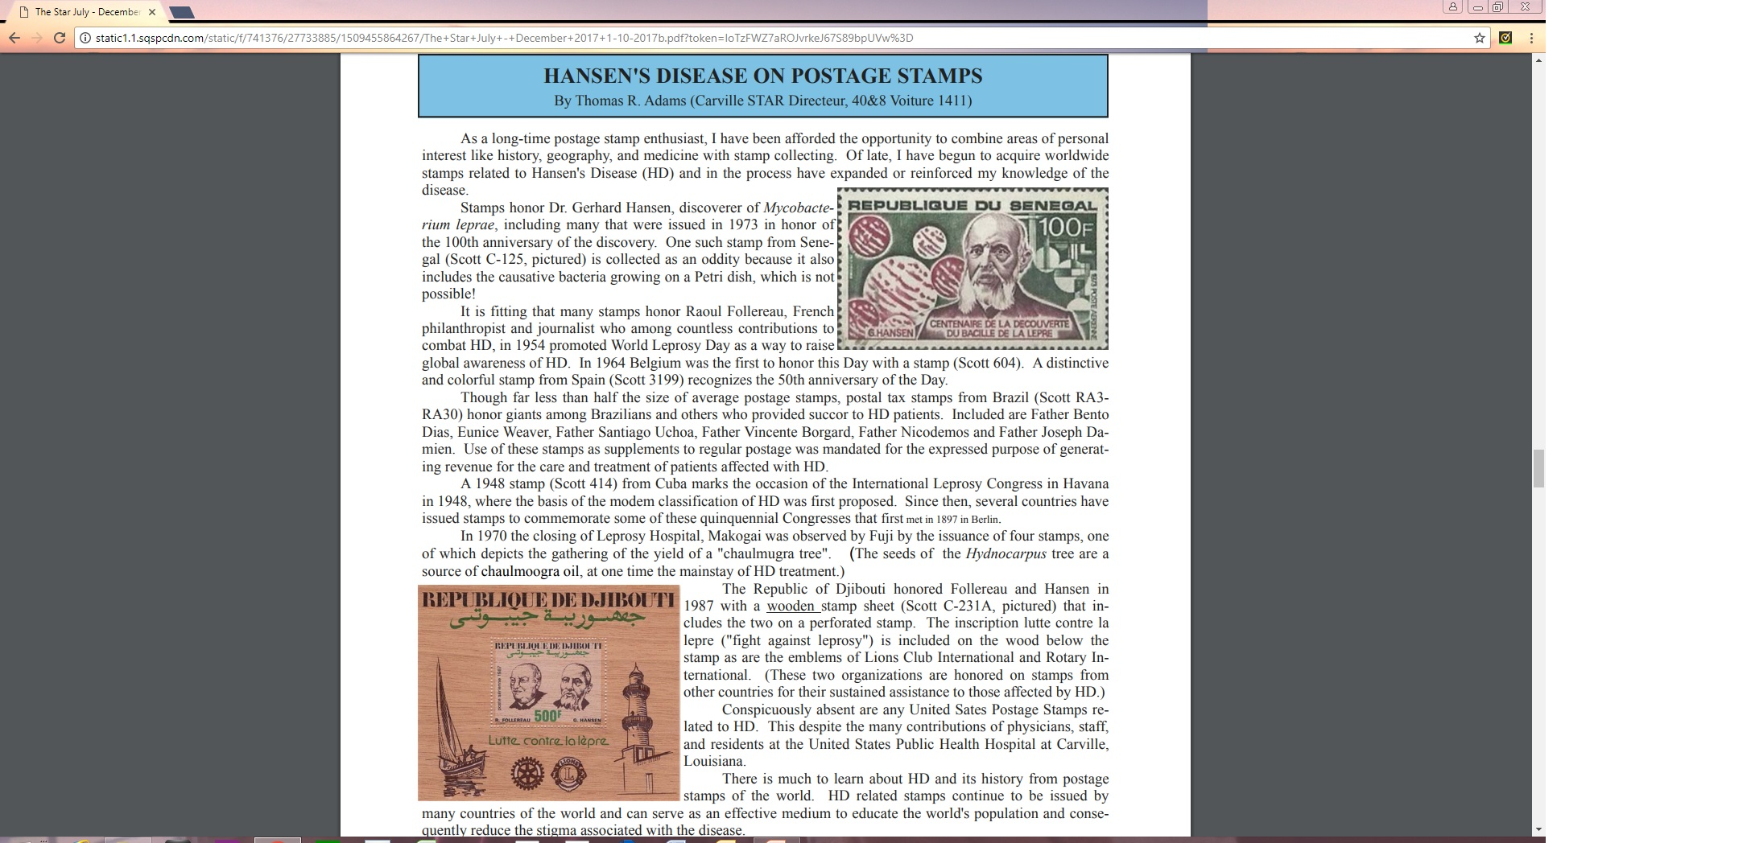
Notes:
-This year my article on HD and Postage Stamps was published in The Star, a publication about HD that is distributed to about 150 countries
In it I discuss this opportunity that stamp collecting affords to “combine passions”
-I also point out how my collection of HD-related stamps includes people, places, events, and “things”

Slide 4
Acquisition Resources For Topical Stamps
Gulfpex Dealers – dealers at Stamp Shows
PostBeeld – and other on-line resources
Lions International Stamp Club
Ebay
Notes:
My concerted efforts to acquire material actually began at Gulfpex this past year
(Dealers at any stamp show can be helpful)
Often I had a number other than the Scoot number limiting the help from dealders
Internet sites like PostBeeld in the Netherlands were sometimes a good source
As was the Lions International Stamp Club
-Then there was Ebay as a source – “leprosy on stamps” nets a section devoted to HD-related stamps
Absent from these resources is the American Topical Association (ATA). You must be a member of ATA to access their database/ lists of topicals and in-turn pay for each topic that you access. Their database includes 110 entries titled “leprosy”

Slide 5
Acqusition Challenges
“Sorting” support from resource
Scott number not used by resource
“Keywords” not included on stamp
Knowledge of people,places,events
Notes:
There were four principal challenges that I encountered and continue to encounter when collecting material

Slide 6
Acqusition Challenges
“Sorting” support from resource
Next slide illustrates filtering capability (by “keyword/keywords” of one internet website, not a characteristic of every resource site)
Notes:
You hope the resource has a built in “sort” capability that supports identifying the material

Slide 7
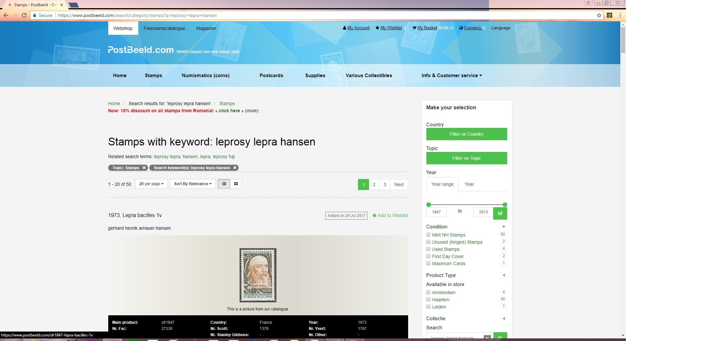
Notes:
Here you see that the internet source includes sort options

Slide 8
Acqusition Challenges
Scott number not used by resource
Thankfully, the Scott number is used by an on-line resource as seen in the next slide though this is often not the case
Notes:
Regretfully , not every resource will give a Scott number which presents a problem for those of us who do not own or have ready access to Scott’s International Catalog.

Slide 9
Notes:
This stamp does include the Scott number as an identifier, but often I found this not to be the case

Slide 10
Acqusition Challenges
“Keywords” not included on stamp
The examples shown in the next slide show 1) Dr Albert Schweitzer outside a leprosy hospital with no “keyword” to indicate his location or that he is holding the children of HD patients and 2) Baba Amte, a highly-revered champion of HD patients in India with no “keyword/s” related to HD
Notes:
Leprosy, Hansen’s Disease, Lepra, Leprosarium or any other what I call “keywords” do not appear on the stamp

Slide 11
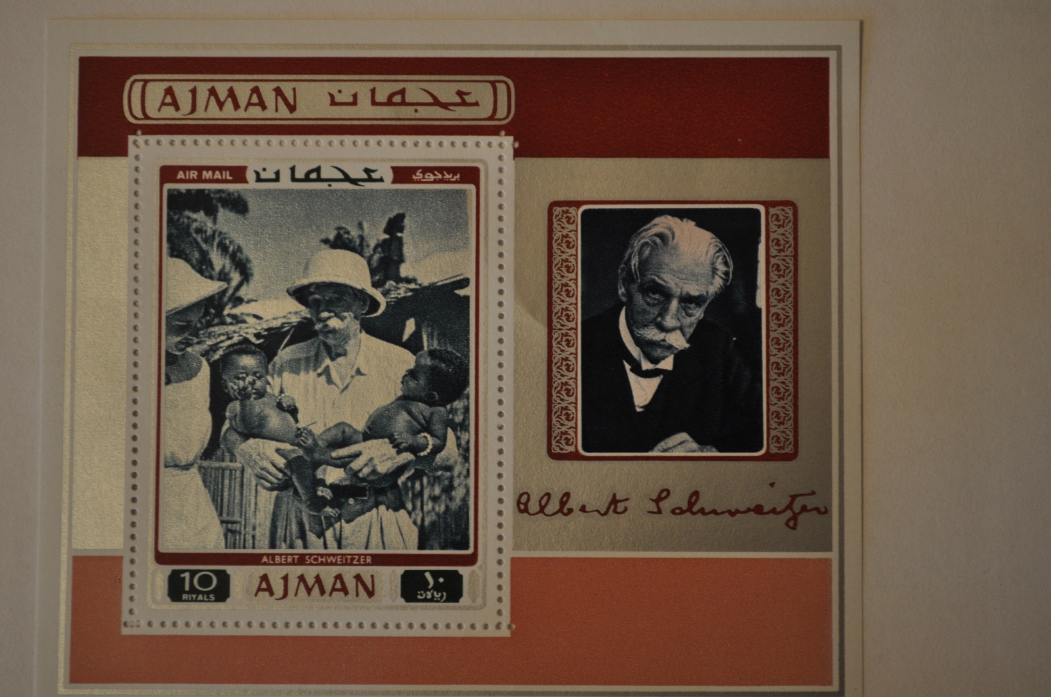
Notes:
This new acquisiition - an airmail sheet from the United Arab Emirates depicts Dr Albert Switzer. Stamps from many countries depict Dr Switzer. In this case Dr Switzer is holding infants in front of a leprosy hospital. My source for this included it as part of the stamp’s description, so I was able to find it on a routine interned search.

Slide 12
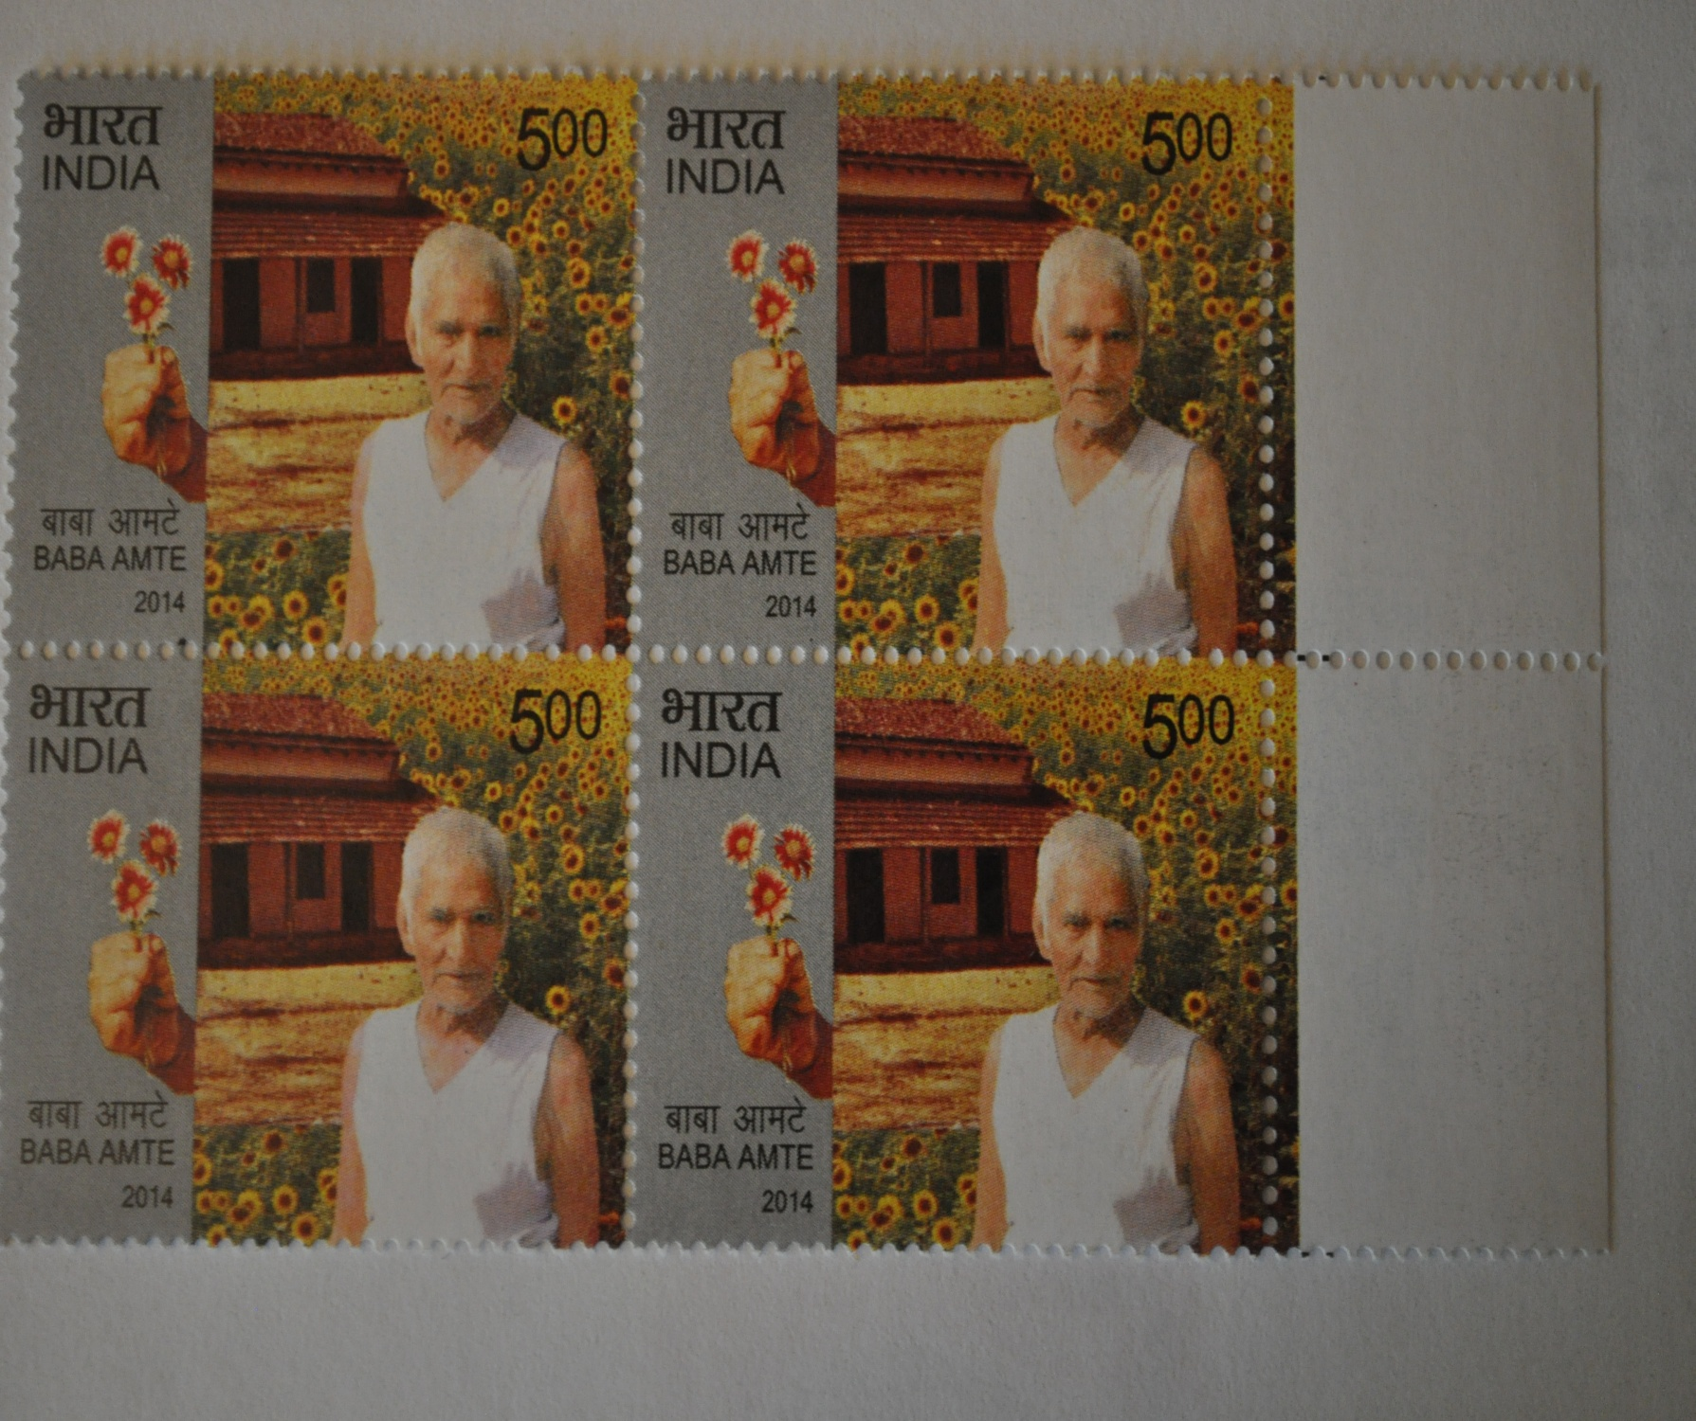
Notes:
This block was similarly obtained – it honors Baba Amte – revered in India –(lived 1914-2008) A disciple of Mahatma Ghandi. Amte founded three ashrams for treatment and rehabilitation of leprosy patients, disabled people, and people from marginalized sections of society. Nowhere on the stamp is there a “keyword” to relate the stamp to HD

Slide 13
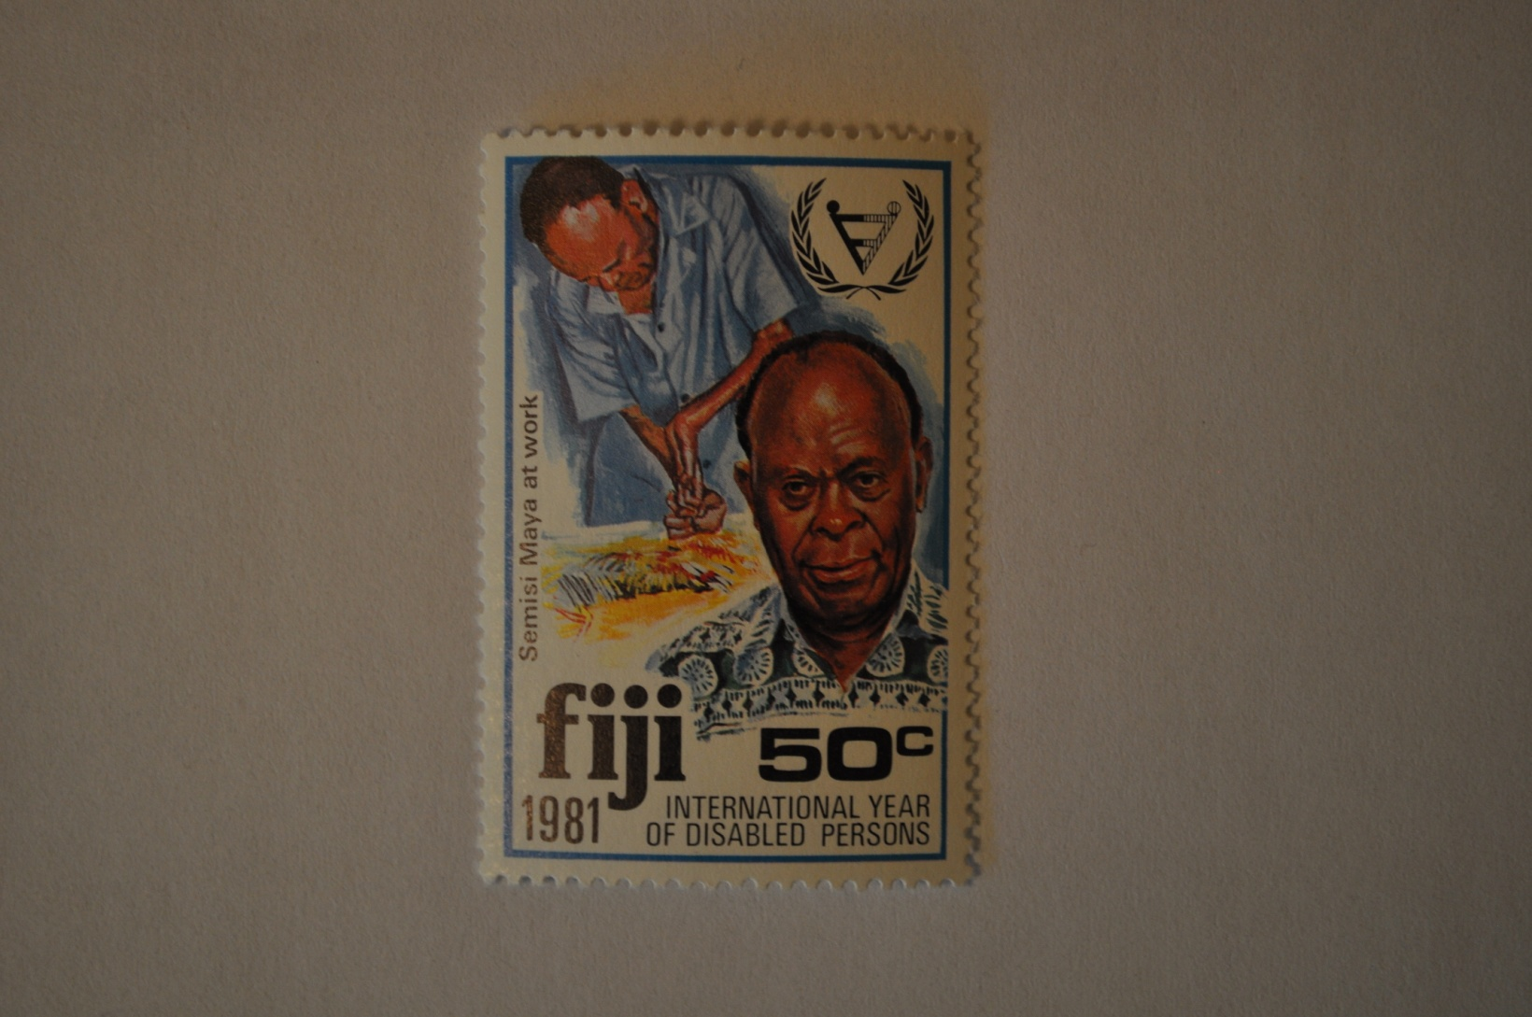
These next two slides feature artist Semisi Maya noted on this slide as a “Disabled Person” with his artwork featured on the stamps of the next slide. (From any of the stamps, there is no apparent indication that Semisi Maya is an HD patient)
Notes:
This stamp honors Semisi Maya , a Fijian artist prominent during the 1970's and 80's for the amazing paintings he created despite being severely crippled by leprosy – A form of “finger painting” that has become a treasured art form. This stamp honors him on “The Year of Disabled Persons” without mention of HD.

Slide 14
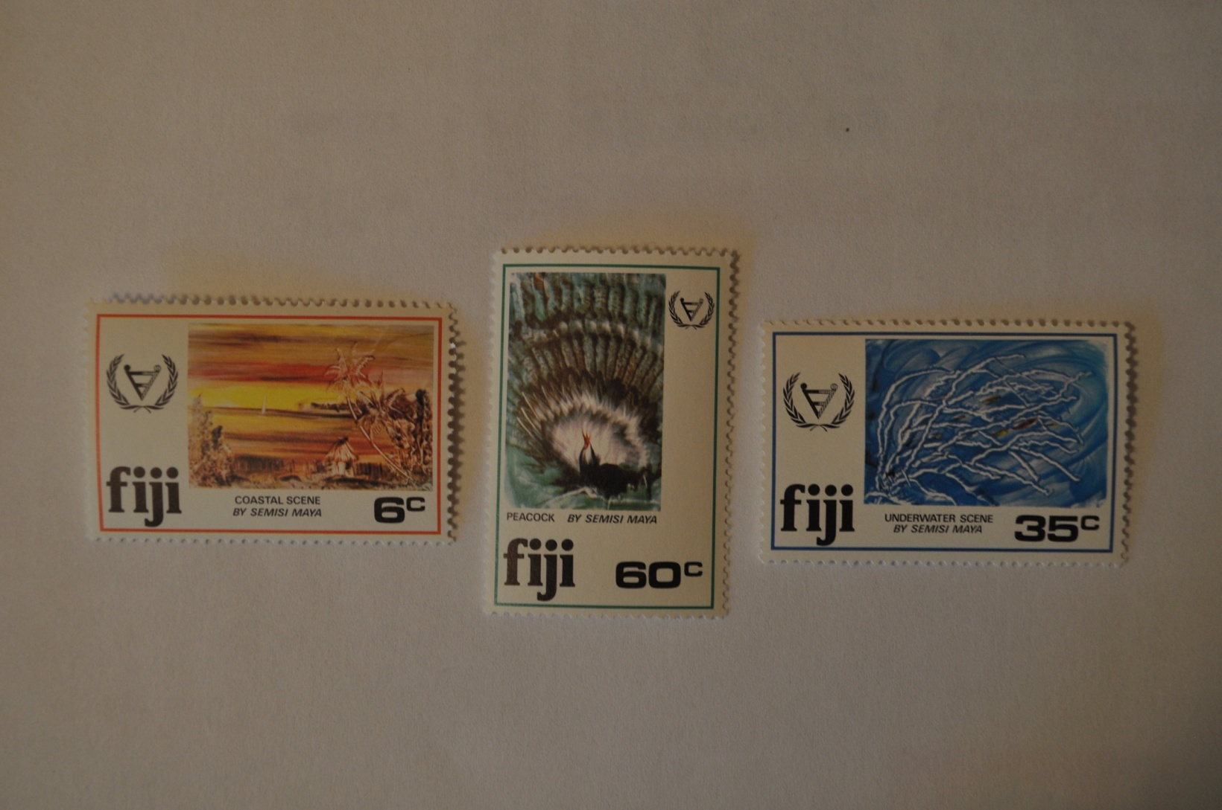
Notes:
Here are 3 of his paintings depicted on stamps that are now part of my collection.

Slide 15
Acqusition Challenges
Knowledge of people,places,events
[Because as seen in the previous examples, a stamp cannot or does not disclose the entire subject matter behind the stamp, it is necessary to study people, places, and events associated with the topic of the collection – in my case, Hansen’s Disease (HD)]
Notes:
It is very important to have knowledge of people, place, events, and things related to the topic of collection.

Slide 16
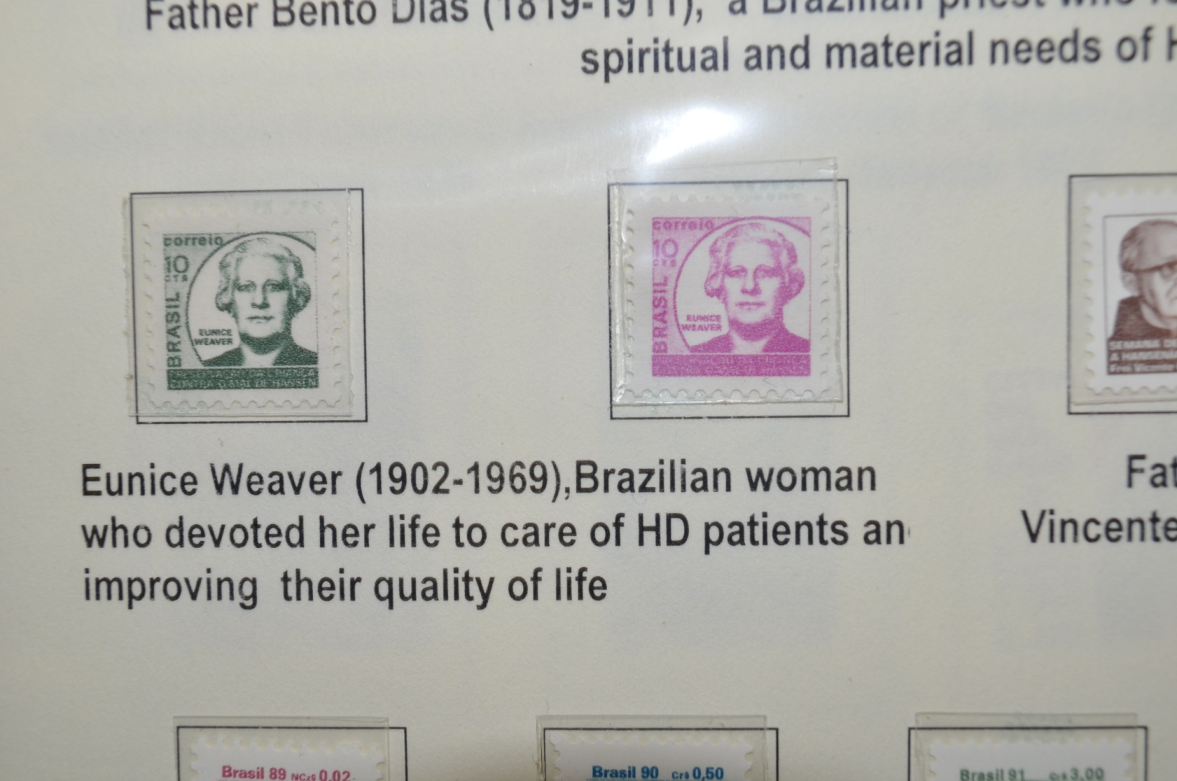
Little is written about Eunice Weaver, a champion of HD patients in multiple countries, establishing leprosariums and centers for the care of children of HD patients. Here she is featured on Brazilian stamps. The next slide shows a photo of Ms Weaver with children she supported.
Notes:
From my exhibit a Gulfpex, these two Brazilian postal tax stamps honor Eunice Weaver. When I put this exhibit together, I could find very limited information about her – and no photographs of her.

Slide 17
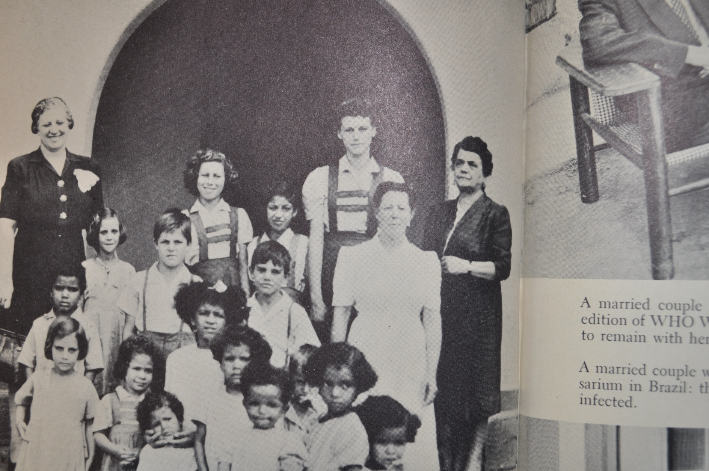
Notes:
Recently I finally found more about this influential woman including this picture of Eunice Weaver with children of leprosy patients. For 30 years she was president of the Federation of Societies for Assistance to Lepers and for Control of Leprosy (formed in 1932). She represented Brazil in numerous international leprosy congresses and organized leprosy services in Paraguay, Cuba, Mexico, Guatemala, Costa Rica and Venezuela.

